Slide 1

Webinar Productivity Maximized using GoToWebinar and Click Dimensions

Slide 2
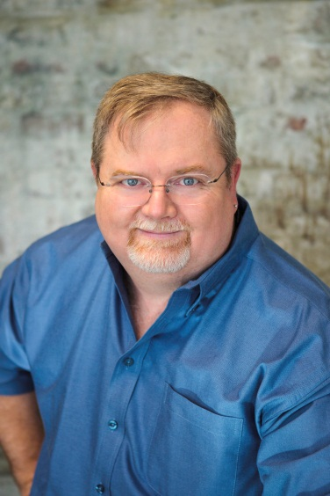
Mitch Milam
Dynamics CRM Architect
Independent consultant
Nine–Time Dynamics CRM MVP
Contact me:
mitch@xrmcoaches.com
Infinite–x.net
@mitchmilam

Slide 3
Teaching Tuesdays
Cast your vote now
http://tinyurl.com/TeachingTuesdays
(Searching for a new home. Just email me with ideas.)
Webinar schedule and recorded webinars
http://www.xrmcoaches.com/webinars

Slide 4
Agenda
Recommended equipment
Setup and Configuration of the Click Dimensions GoToWebinar connector
Planning your webinar
Reducing webinar SPAM (yes, there is such a thing)
Marketing your webinar
Conducting your webinar
Collecting attendance statistics
Communicating with both registrants and attendees
Recording your webinar and publishing it to YouTube

Slide 5
Hardware

Slide 6
Monitors
Use two monitors
One for the presentation
Second for monitoring
Reduce the screen resolution

Slide 7
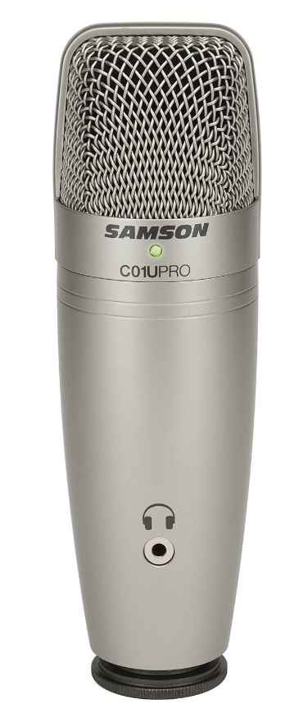
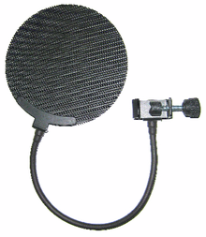
Microphone
Use a real mic, not a headset
Use a microphone stand
Do not use a desktop stand
Use a pop filter

Slide 8
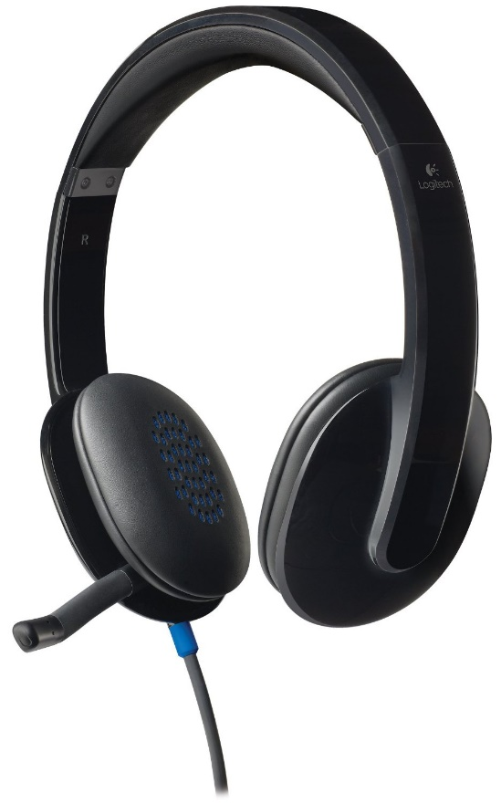
Headphones
Use quality headphones

Slide 9
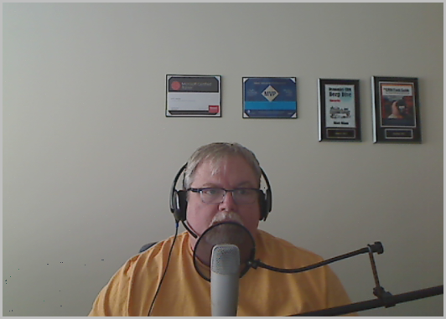
My Rig

Slide 10
GTW Connector
Setup

Slide 11
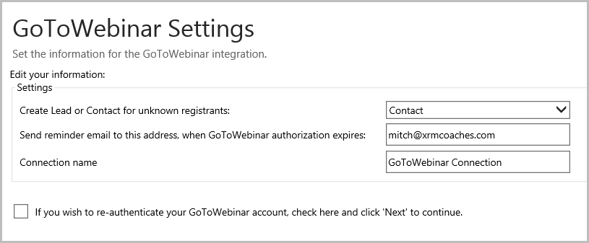
GoToWebinar Connector
Navigate to:
Settings, Click Dimensions Settings, Connectors
Click the Add button

Slide 12
Planning

Slide 13
Monetization
Free or paid webinar?
If paid, how will tickets be sold?
(I use EventBrite)

Slide 14
Audience
Define your audience
Research where they hang out
Define a marketing strategy to match

Slide 15
Content
Actual presentation
Supporting materials
Handouts
Cheat–sheets
Diagrams/flowcharts
Always record the webinar

Slide 16
Things to Consider
Time of day
Required registration information

Slide 17
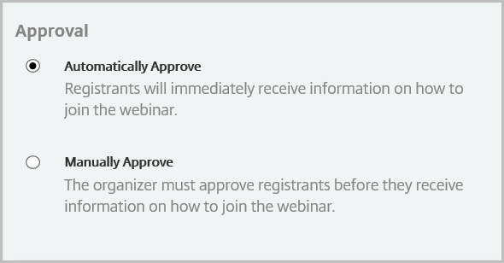
Registration Approval

Slide 18
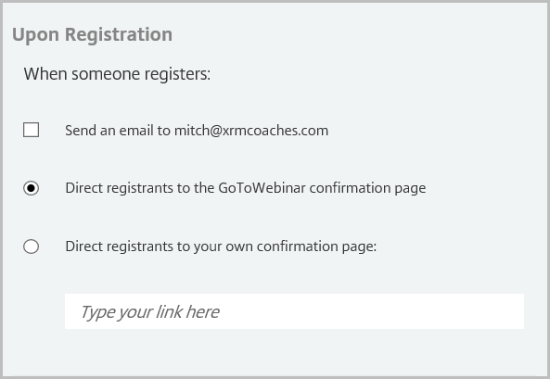
Email Confirmation

Slide 19
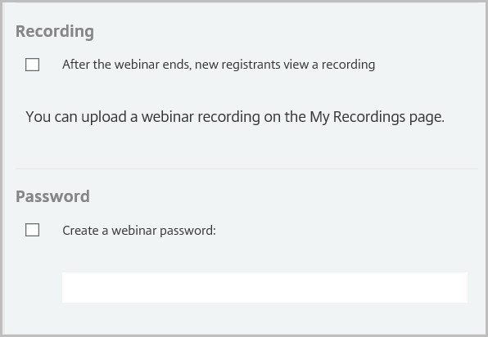
Additional Settings

Slide 20
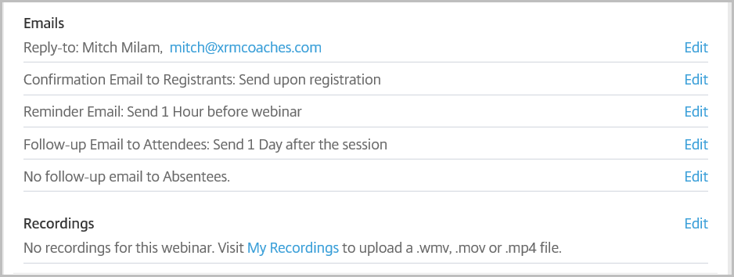
GoToWebinar Notifications

Slide 21
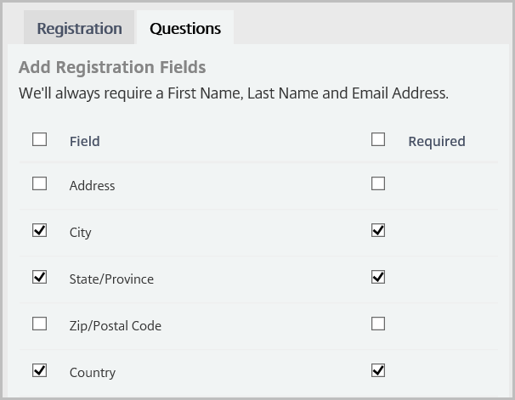
Demographic Information
Only ask for relevant information

Slide 22
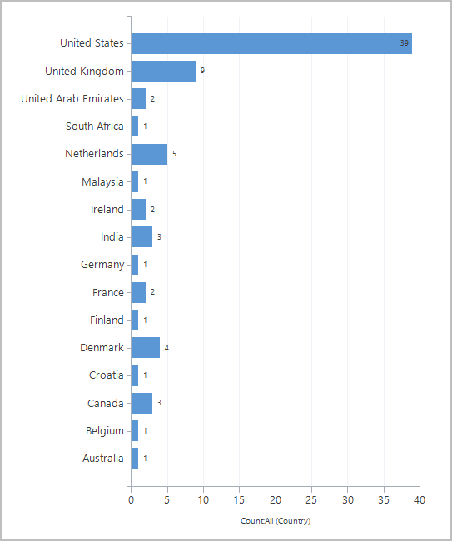
Today’s Webinar Demographics

Slide 23
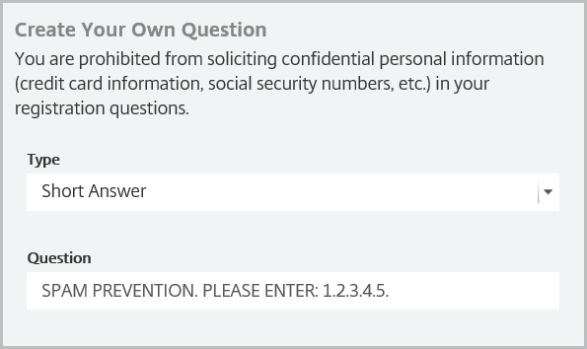
SPAM Prevention

Slide 24
Email Templates
Webinar announcement
Webinar follow–up
Attendees
Non–attendees
Registrants

Slide 25
Automation

Slide 26
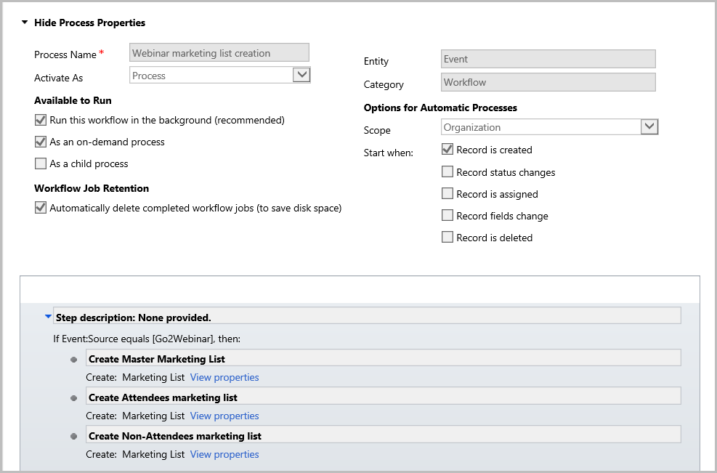
Automatic Marketing List Creation

Slide 27
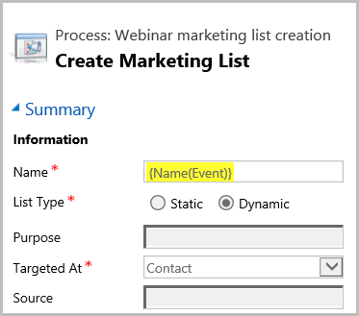
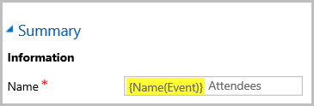
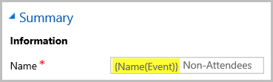
Marketing List Properties

Slide 28
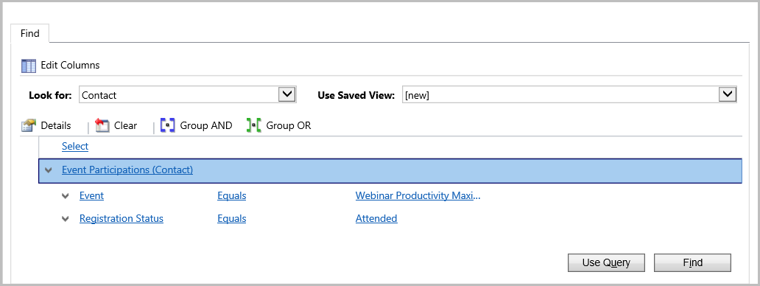
Attendee Membership

Slide 29
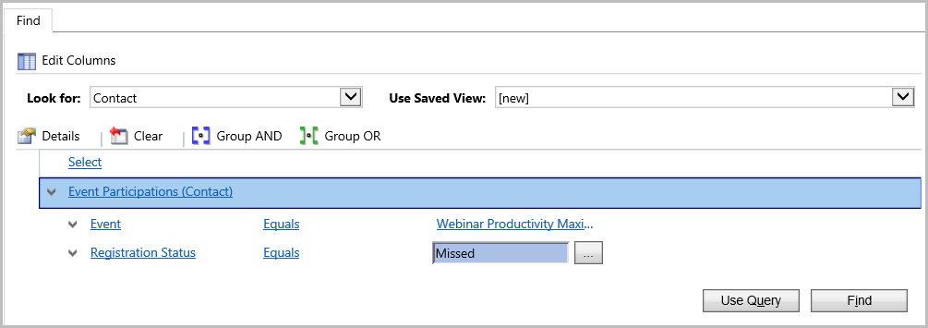
Non–Attendee Membership

Slide 30
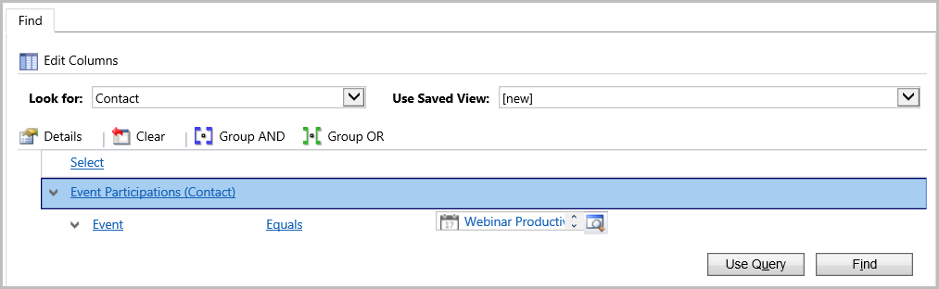
All Registrants

Slide 31
Marketing

Slide 32
Distribution Channels
Company blog
Email
LinkedIn
Facebook
Google+
Twitter

Slide 33
Considerations
“Stickiness” will determine frequency

Slide 34
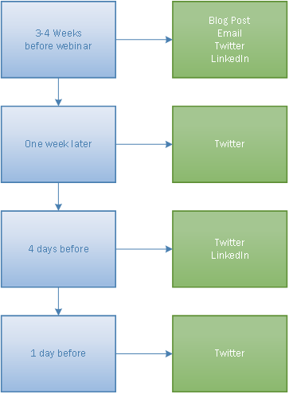
Calendar

Slide 35
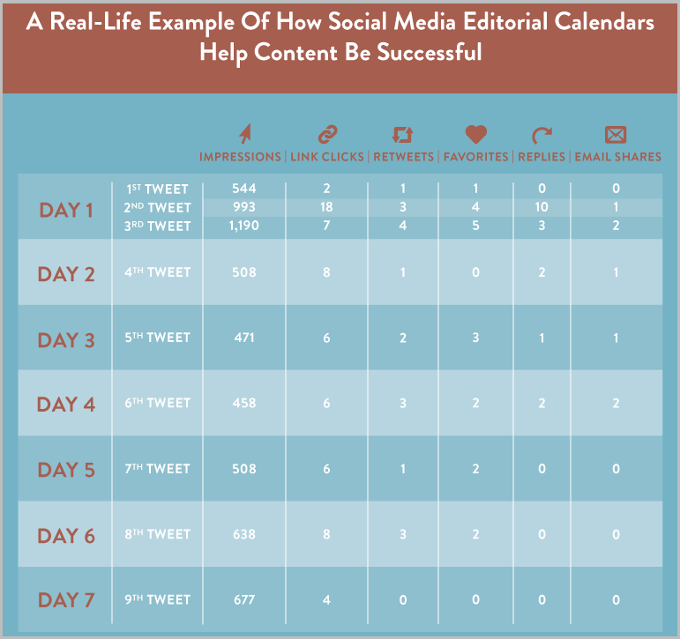
Real–Life Example
Source: http://coschedule.com/blog/how-to-quadruple-your-traffic-with-a-social-media-editorial-calendar

Slide 36
Tools
CoSchedule

Slide 37
Conducting the Webinar

Slide 38
Workspace Preparation
Do not install updates or reboot the day of the webinar
Shut down all non–essential applications
Make sure any Pop–ups are disabled
Put your phone on silent or turn it off

Slide 39
Physical and Mental Preparation
Practice talking
Take a short walk (use the restroom)
Get comfortable
Verify your microphone location
Verify your sound level
Have a full glass of water
Take a big drink before you start

Slide 40
Before the Webinar Starts
Before you hit the Broadcast button:
Start your PowerPoint presentation
Start screen sharing
After your opening screen is shown, pause screen sharing
An alternative is to use the GoToWebinar custom theme

Slide 41
Startup Process
When should you start?
On time?
Wait a few minutes?

Slide 42
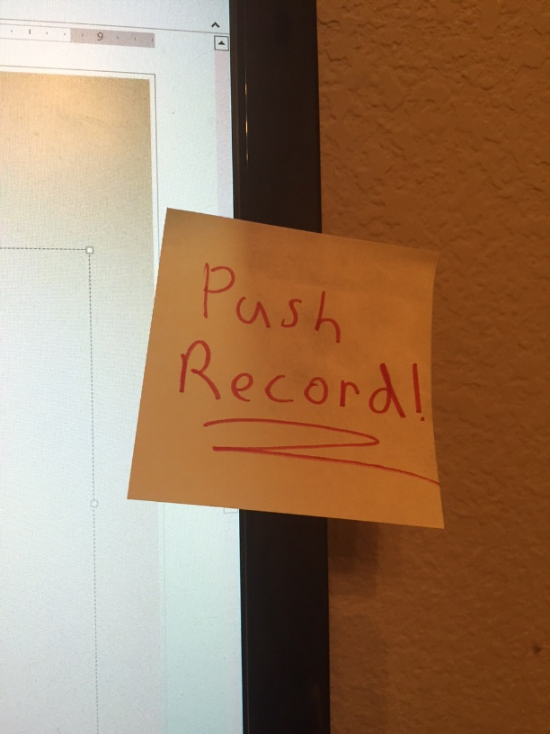
Push Record

Slide 43
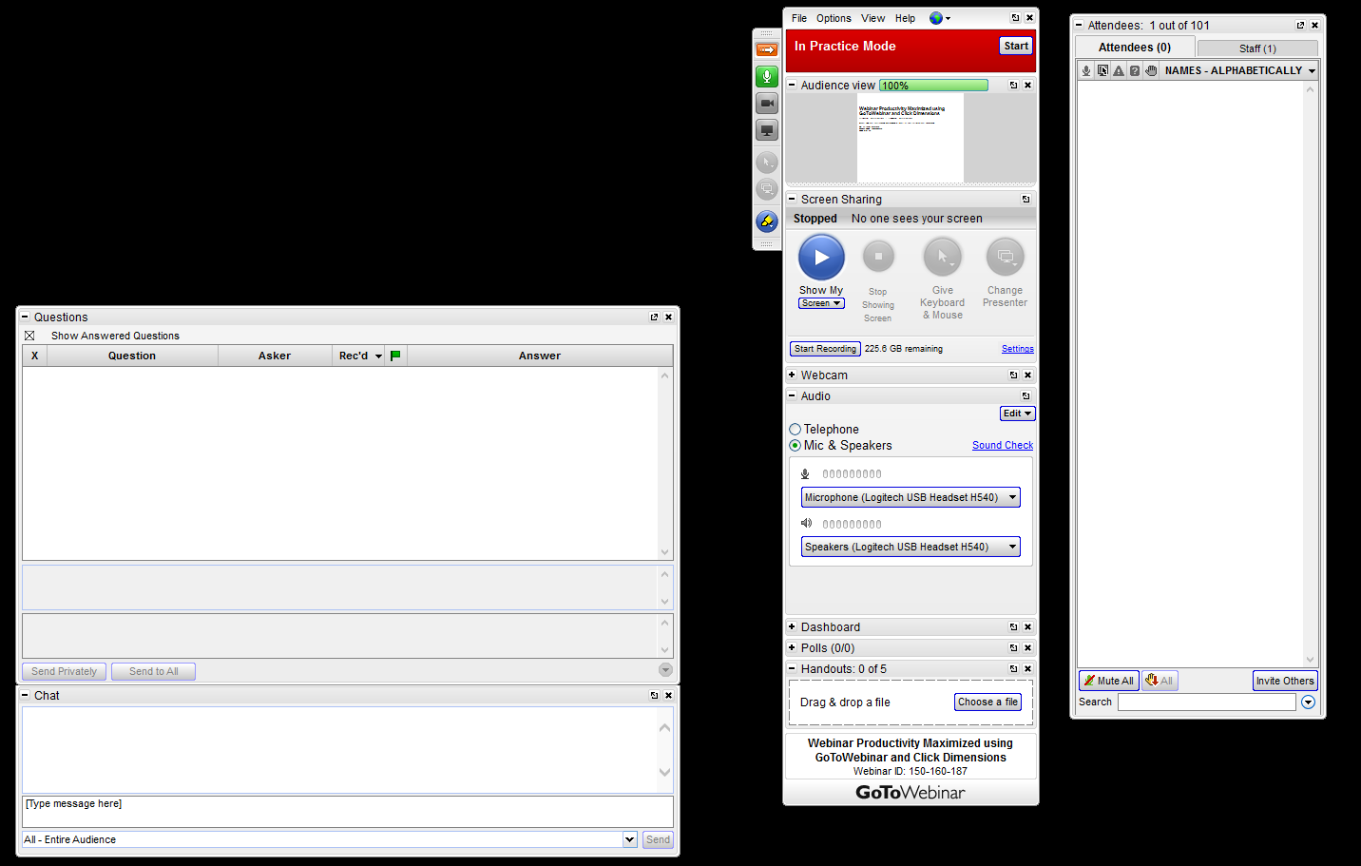
Window Configuration

Slide 44
Post–Production

Slide 45
Webinar Recording
Start the conversion process immediately after the webinar concludes
Always use the .WMV format
Start the upload process to YouTube when conversion is complete

Slide 46
YouTube
Do you have a YouTube Channel?
If not, create one

Slide 47
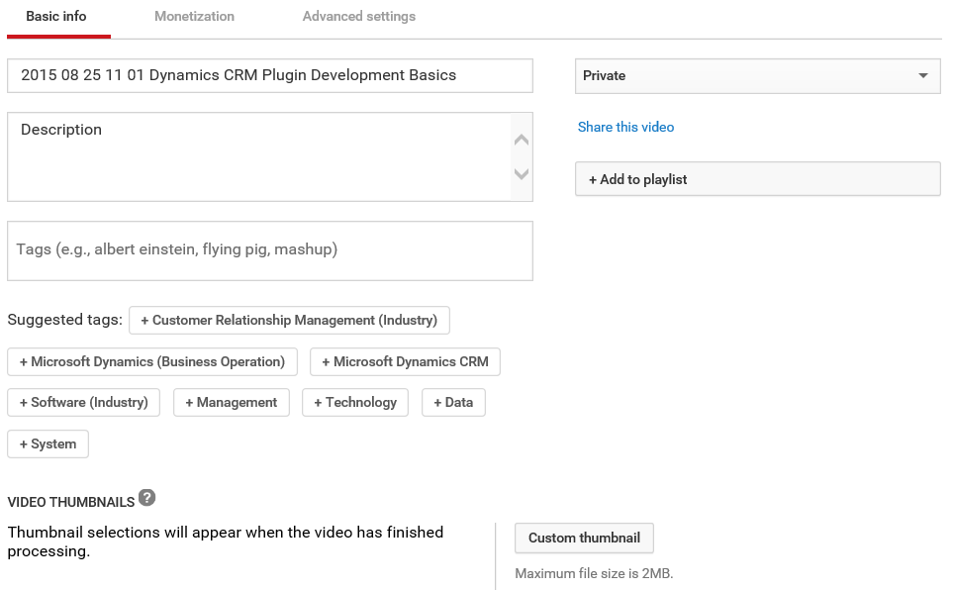
Video Settings

Slide 48
Considerations
How are you presenting your recording to your users?
Do you need to include Q&A?

Slide 49
Follow–Up

Slide 50
Communications
Tweet a link to the recording
Send an email to attendees
Send an email to everyone
Send an email to those who did not attend
Do you use GoToWebinar or Click Dimensions for email?

Slide 51
Considerations
Wait until the end of the day to send emails
Allows for your YouTube video to become live
Allows for Click Dimensions to fully synchronize with GoToWebinar

Slide 52
Analysis

Slide 53
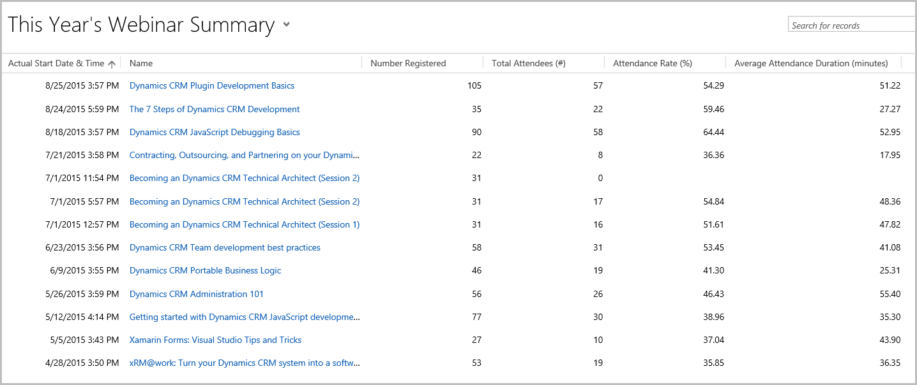
Statistics

Slide 54
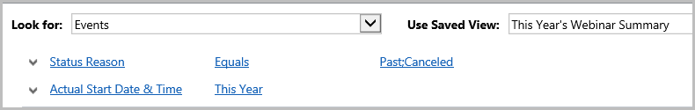
Statistics (Advanced Find)

Slide 55
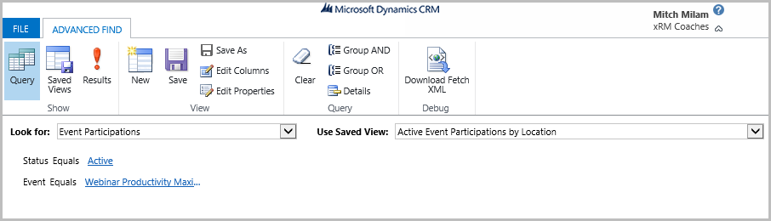
Demographics (Advanced Find)

Slide 56
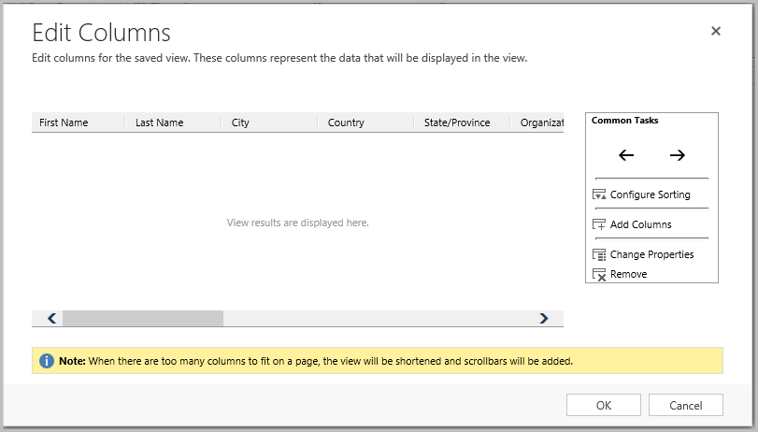
Demographics (Edit Columns)

Slide 57
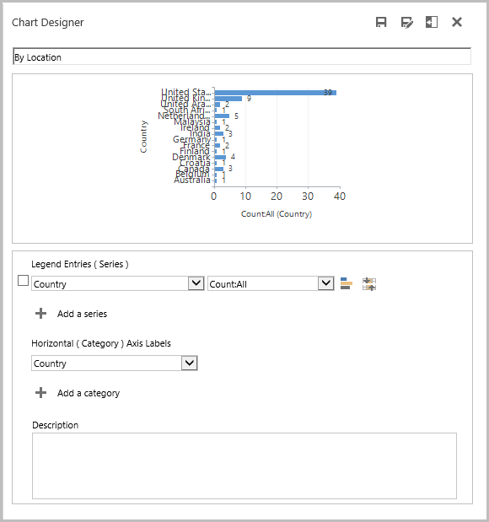
Demographics (Chart)

Slide 58
Recap
Recommended equipment
Setup and Configuration of the Click Dimensions GoToWebinar connector
Planning your webinar
Reducing webinar SPAM (yes, there is such a thing)
Marketing your webinar
Conducting your webinar
Communicating with both registrants and attendees
Recording your webinar and publishing it to YouTube
Collecting attendance statistics

Slide 59
What did I miss?

Slide 60
Questions?

Slide 61
Bonus Materials
If you are watching the recording, visit:
http://www.xrmcoaches.com/webinarkickstart
(If you registered for this webinar, you will automatically receive the bonus materials in the follow–up email)

Slide 62
Thank You

